Slide 1
Women in Film and Box Office Revenue
Jonathan Shepard

Slide 2
The Research Questions
How much “screen time” (as represented by F%) do women get in films?
What is the nature of the relationship between women’s ‘screen time’ in a film, and the expected box office revenue of that film?
NOT intended as generalizable predictive model

Slide 3
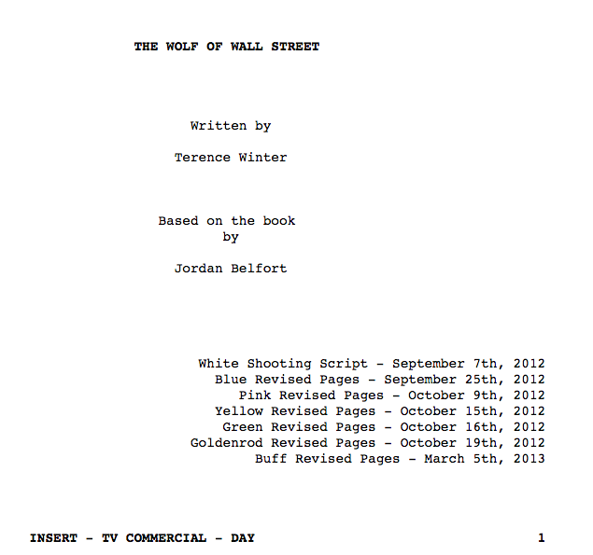
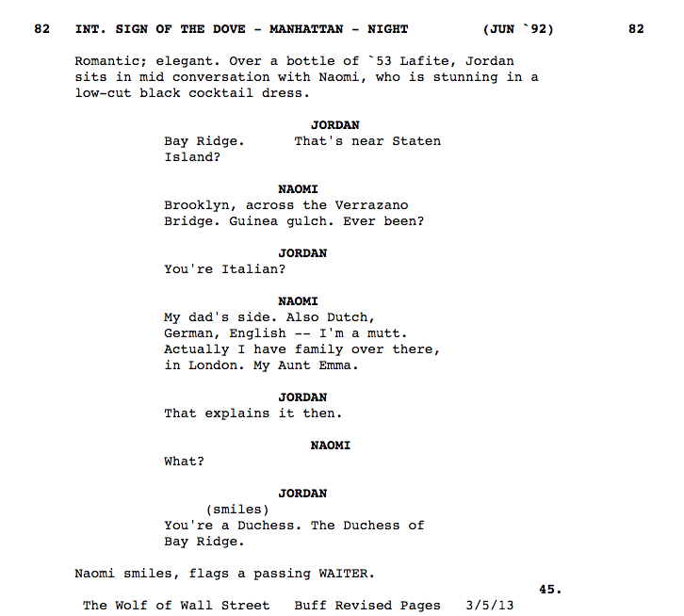
Screenplay Formatting
Script Analysis

Slide 4
Data Extraction Process
Script Source: imsdb.com
Financial data source: the-numbers.com
3-step coding process:
1. Extract a list of characters (find all boldfaced text by itself on a line without a blank line after, eliminate duplicates)
2. Manually tag sex of characters vs. N/A
3. Count nonblank lines beneath each character until a blank line is reached
REPEAT A MILLION TIMES
- Jim’s wisdom

Slide 5
Are the data accurate? Mostly.
Selection Bias – towards critically/commercially successful movies
Sex-matching process imperfect
Screenplays often early drafts, not final
F% as proxy for female screen time
Parentheticals and other errors
STILL! MOSTLY PRETTY GOOD.

Slide 6
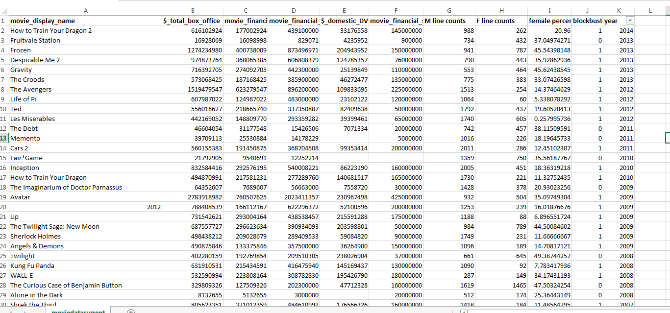
The Data n= 97 (50 BB, 47 non-BB)

Slide 7
QUESTIONS?

Slide 8
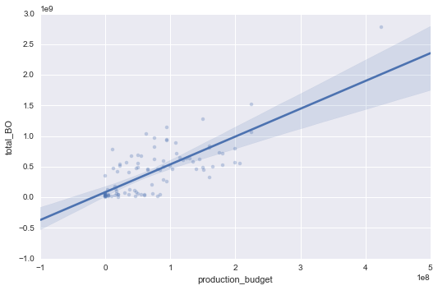
Production Budget (100s of millions) vs. Total Box Office Take (billions)
THESE MOVIES ARE SUPER PROFITABLE ($5 return for $1 investment)

Slide 9
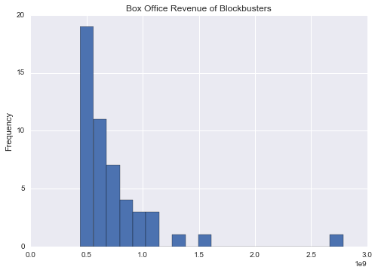
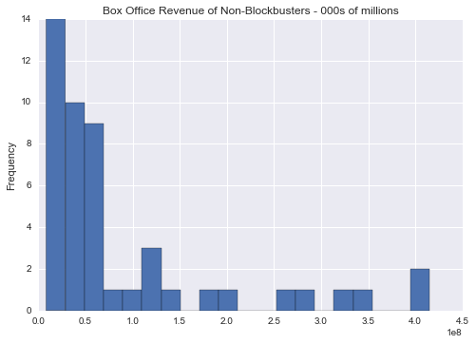
Blockbuster Revenue Distribution
Non-Blockbuster Revenue Distribution

Slide 10
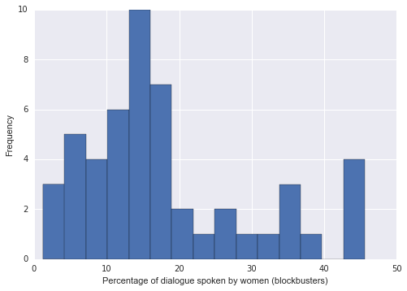
Blockbusters: Percent of Lines Spoken by Women

Slide 11
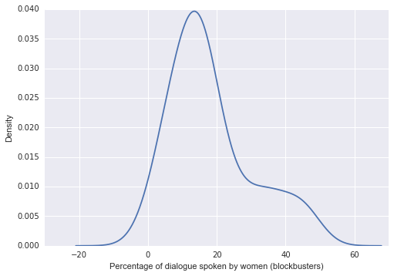
Blockbusters: Percent of Lines Spoken by Women

Slide 12
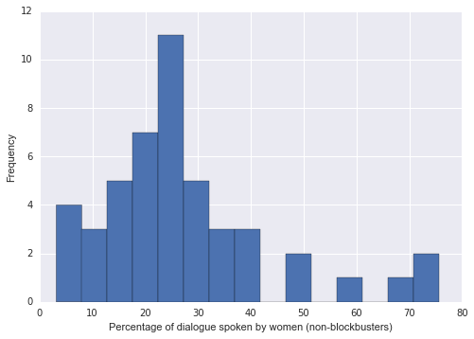
Non-Blockbusters: Percent of Lines Spoken by Women

Slide 13
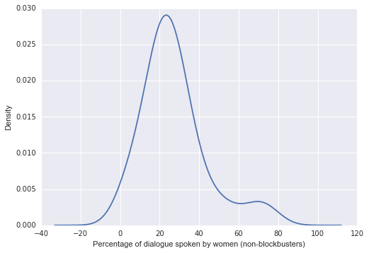
Non-Blockbusters: Percent of Lines Spoken by Women

Slide 14
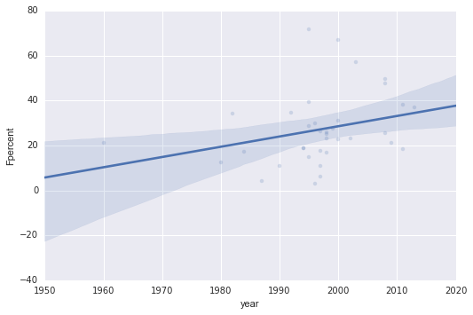
ARE THINGS IMPROVING?
Non-blockbusters

Slide 15
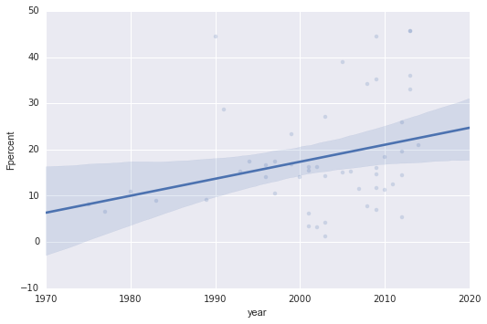
ARE THINGS IMPROVING?
Blockbusters

Slide 16
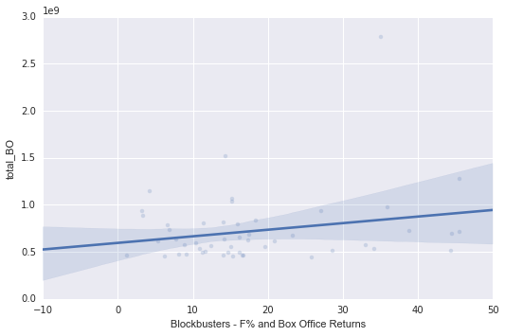
Intercept | $272.9 million
β: production budget | $3.19
β: F% | $4.586 million
Blockbusters: F% and Box Office Returns

Slide 17
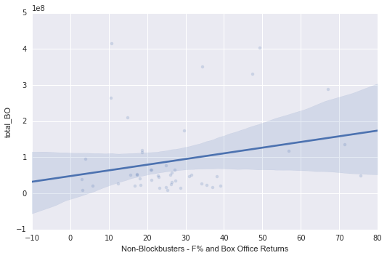
Intercept | $846,168
β: production budget | 1.31
β: F% | $2.008 million
Non-Blockbusters: F% and Box Office Returns

Slide 18
Conclusions
Percentage of women’s dialogue in movies is low (more so for blockbusters)
Increasing steadily but slowly over time
Production budgets are generally stronger predictors of gross revenue
F% is associated with increases in gross revenue for both blockbusters and non-blockbusters
This effect is often “drowned” out by the “production budget” or “blockbuster” effect.

Slide 19
Possible Future Directions
More scripts!
More explicit testing for “representativeness” of script samples
More ? for women?
Do things change if the director/screenwriter is female?

Slide 20
QUESTIONS?

